Slide 1
RoundTable Presentation
By Dylan Henry

Slide 2
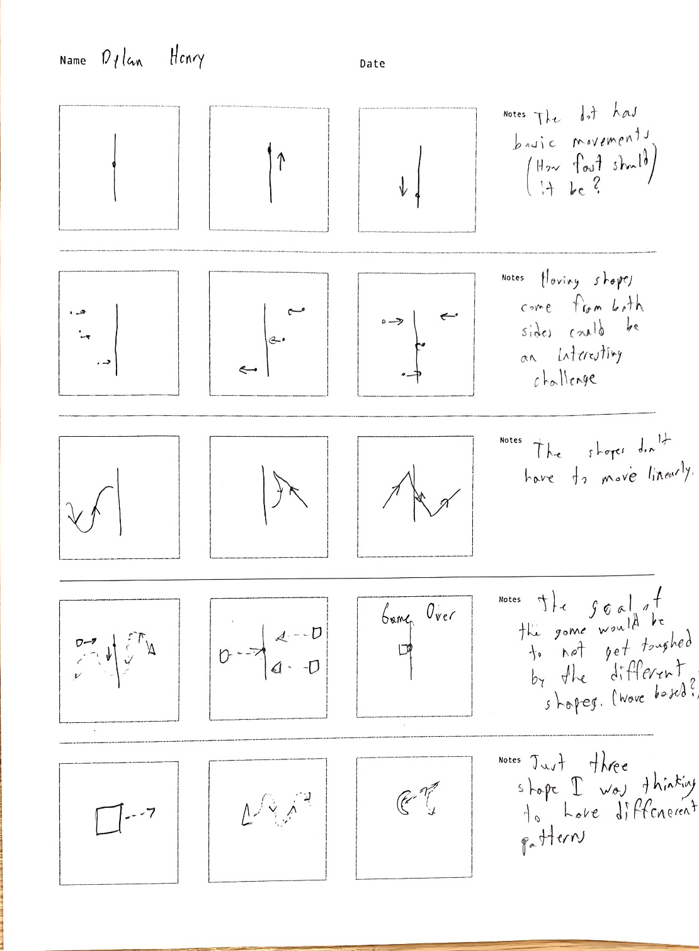
Idea 1

Slide 3
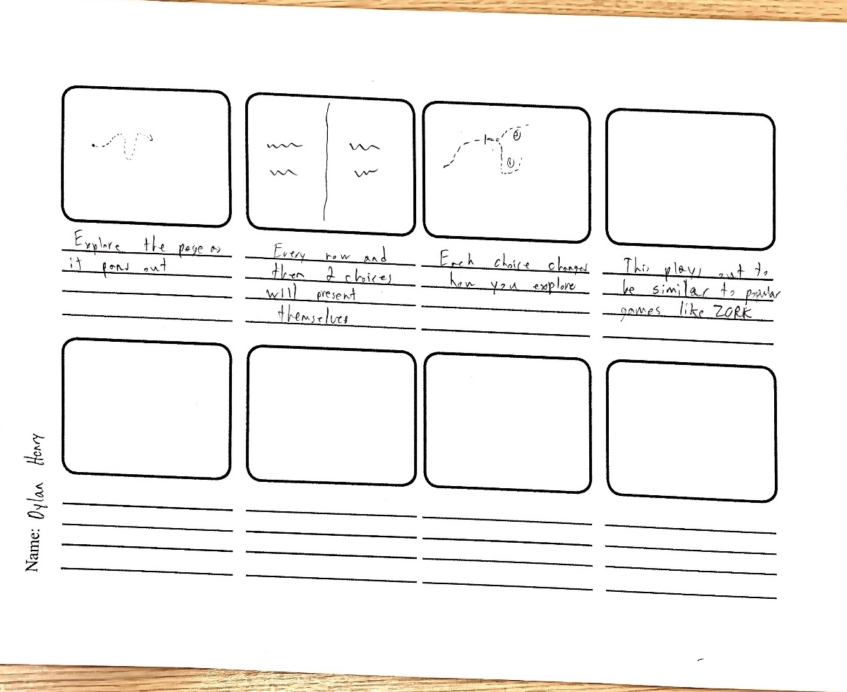
Idea 2 (Zork Esque Game)
Notes:
https://en.wikipedia.org/wiki/Zork

Slide 4
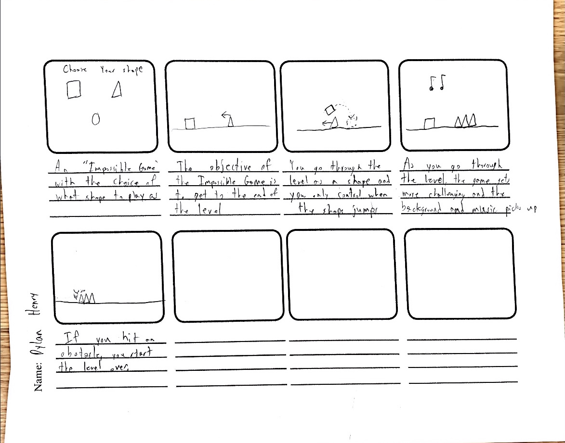
Idea 3 (Impossible Game)

